Slide 1

Deep Learning

Slide 2
What is deep learning (DL)?
Deep Neural Network models have more than 2 hidden layers, sometimes hundreds of layers!
Deep Learning (DL) addresses how such models are trained.
DL usually requires high computational resources, and effectively utilize Graphical Processing Units (GPUs), which perform array operations in hardware.
DNNs have a large number of parameters, hence require a large amount of training.
DL has been applied with extraordinary success to solving difficult problems, e.g., in image analysis.

Slide 3
Why has DL been so successful?
The composition of multiple (nonlinear) functions represents real-life processes more accurately.
Each layer can represent a different type of mapping.
Early layers usually perform explicit feature identification.
Each layer may be trained using a different approach, with explicit regularization.

Slide 4
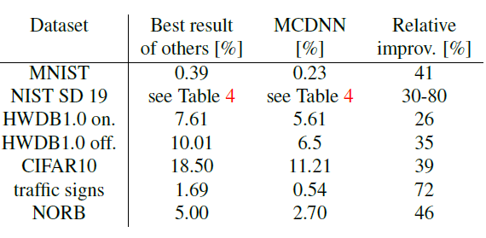
Breakthrough results in speech recognition and image classification …
From this Hinton et al 2012 paper:
http://static.googleusercontent.com/media/research.google.com/en//pubs/archive/38131.pdf
http://yann.lecun.com/exdb/mnist/
http://people.idsia.ch/~juergen/cvpr2012.pdf

Slide 5
Vanishing and Exploding Gradients
Recall: backpropagation (BP) relies on the chain rule.
In a DNN, if we use BP, we need to multiple tens of numbers to compute weight changes for the hidden layer that is ten steps away from the output.
If a few of the multiplied numbers are almost 0, the product is 0, hence no change in weight.
If all of the multiplied numbers have large magnitude, the product is very large, leading to a huge change in the connection weight in a single iteration.

Slide 6
Can we just use Backpropagation?
Each layer of back-propagation weakens the error “signal” coming from outer layers, so that the earliest layers of weights change too slowly.
Too many weight parameters, resulting in over-fitting and poor generalization.
Some tasks require “memory” (recent inputs), not possible in strictly feedforward networks.

Slide 7
The problem with “global” learning in BP
Backpropagation-style learning algorithms focus on “global learning” over the entire data set: each connection weight (in a layer far from the output) is affected by a large number of factors, often pulling in opposite directions.
Multiple efforts by global learners may cancel each other without improving overall performance.
Could some layers instead be trained separately from the others?

Slide 8
Heterogeneity
In BP, all layers “look” the same, and are modified similarly.
Instead, some layers in a DNN could be designed to accomplish specialized tasks, and trained to accomplish the same, almost independently from other layers.

Slide 9
Reducing the number of weights
The number of learnable weight parameters in a DNN can be extremely large.
A huge amount of data would be needed to train the same using BP.
For well-known problems (e.g., image analysis):
Not every node needs to be connected to every node in the next layer.
Many parameters can be forced to be 0.
Many parameters can be constrained to be identical.
The node functions can be simpler (e.g., ReLUs have derivatives of either 0 or 1)

Slide 10
What is special about images?
Localization of features
Need for translation invariance
Convolutional NNs restrict learning to models that enforce these (using “infinitely strong priors”), thereby reducing the potential search space! Implementations will have:
sparse localizing layers (most weights=0) and
spatial pooling (produce same results with small translations of inputs).

Slide 11
Useful Innovations
Unsupervised feature learning prior to classification.
Regularization by enforcing equality constraints between many weights.
Transfer learning (using features other tasks).
Recurrent connections and memory units.
Use of powerful hardware!

Slide 12
What deep NN models to use and when?
Prediction over time (e.g., weather, stock prices): Recurrent NNs whose early layers contain Long Short Term Memory (LSTM) units and their variants
Image analysis (e.g., face recognition): convolutional NNs.
Text processing & generation (e.g., LLMs): transformers
Generating realistic images (e.g., art): Generative-Adversarial NNs
Many of the above also use autoencoder layers (trained separately) containing an encoder that reduces dimensionality, followed by a decoder that recovers a vector similar to the inputs. These have also been used for feature extraction and image generation.

Slide 13
Recurrent Neural Networks
Prediction over time requires remembering the past in some form—not just memorization, but learning what in the past is relevant for the future.
Remembering is facilitated by “recurrent” NNs (RNNs), i.e., containing cycles.
Learning connection weights in RNNs is hard, unless done systematically with severe constraints on the NN architecture.
Backpropagation on RNNs confronts the obstacles of vanishing/exploding gradients.

Slide 14
Recurrent Neural Networks with Gated Units
Modern recurrent NNs use many copies (in one or more hidden layers) of small modules containing recurrent connections, internal state memory, and “gates”.
Gates are designed to facilitate forgetting unnecessary information, remember new info., and modify internal memory.
The error signal from the recent past is modified and remembered over time.
The most commonly used modules are Long Short Term Memory (LSTM) and Gated Recurrent Units (GRUs).
GRUs are simpler versions of LSTMs, with fewer gates.
In addition to predictions over time, such models have been shown to be effective for tasks such as speech recognition.

Slide 15
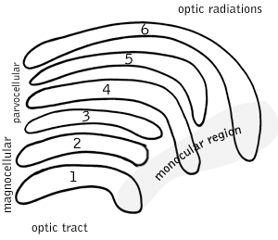
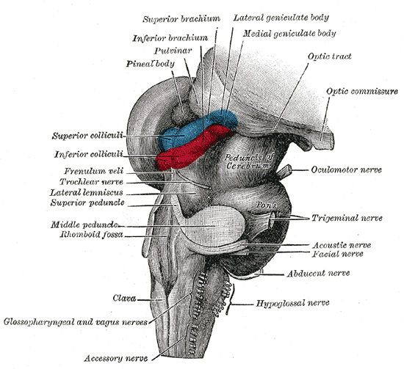
How does the human visual processing system work?
6 layers in the visual cortex!

Slide 16
What do hidden layers achieve in image analysis problems?
First hidden layer: very simple features (e.g., small curve)
Second hidden layer: more complex features (e.g., two curves that join)
Third hidden layer: even more complex features (e.g., nose shape outline)
…
Output layer: classification (e.g., dog vs. cat)

Slide 17
Hence the motivation for multiple layers: to learn lower and high level features

Slide 18
Convolutional layers
Convolution: A small linear feature detector e.g., a 3x3 array [[ 0 1 0][0 1 0][0 1 0]] looks for a vertical line segment in a small part of the input image
Multiple convolutions can be applied in parallel, so that we are simultaneously looking for many kinds of features.
Translational invariance is achieved by “pooling” the results over the entire image, answering questions such as: “is there a vertical line segment anywhere in the image”.

Slide 19
Systematic composition of features
Simple features detected in earlier layers are combined to form more complex features in later layers.
Having more layers enables extremely complex features to be learnt.
Hence depth is better than breadth, i.e., it is better to have more layers (with fewer nodes in each layer) than shallow NNs with many more nodes in each layer.

Slide 20
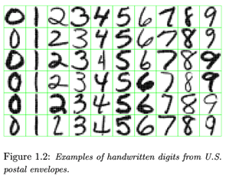
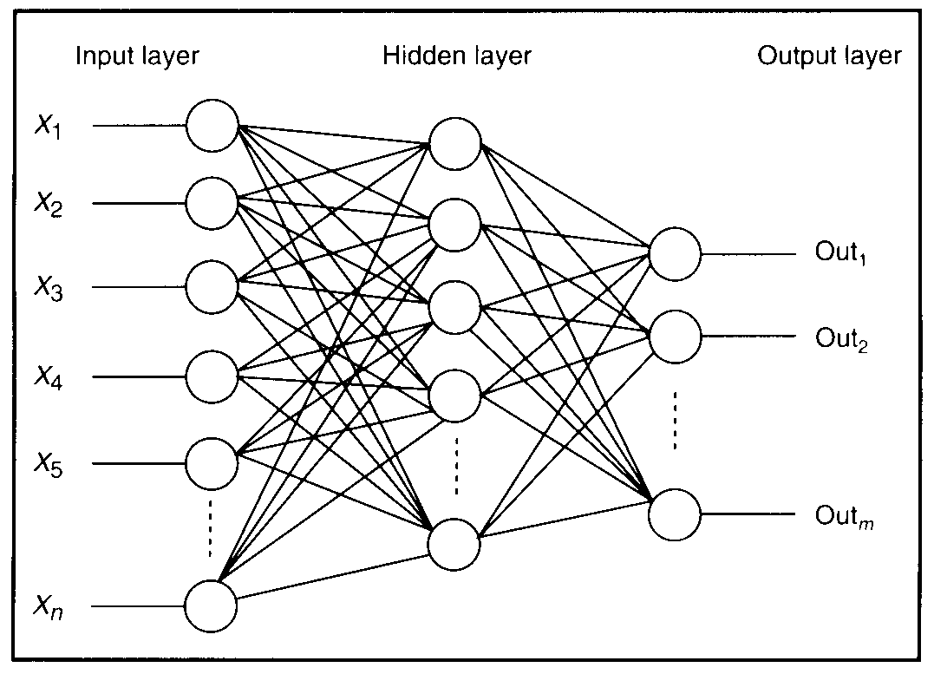
what is this unit doing?

Slide 21
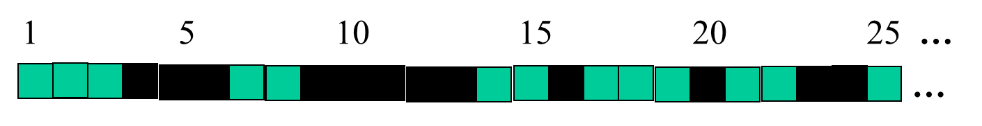
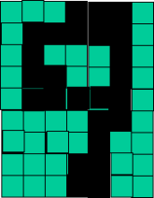
successive layers can learn higher-level features …
detect lines in
Specific positions
etc …
Higher level detetors
( horizontal line,
“RHS vertical lune”
“upper loop”, etc…
etc …
v
What does this unit detect?

Slide 22
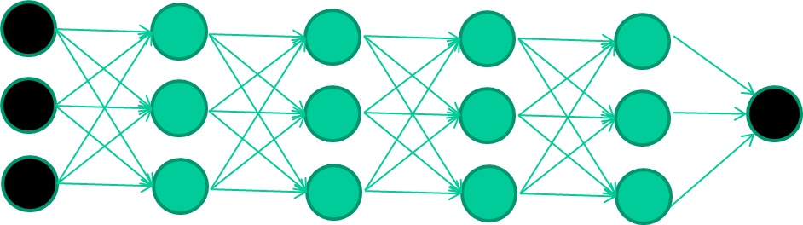
An alternative to backpropagation
Train this layer first
then this layer
then this layer

Slide 23
The new way to train multi-layer NNs…
EACH hidden layer is trained to be an auto-encoder
forced to learn good features that describe what comes from the previous layer

Slide 24
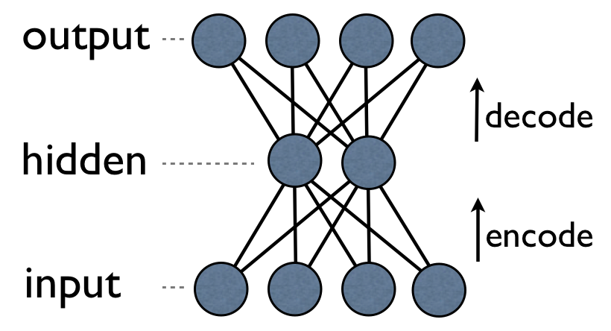
Each auto-encoder is trained, with an absolutely standard weight-adjustment algorithm to reproduce the input
By making this happen with (many) fewer units than the inputs, this forces the ‘hidden layer’ units to become good feature detectors

Slide 25
Attention Mechanism (for text processing): addresses how much one token affects another
Each token (word or phrase) is represented using a numerical vector.
Three weight matrices (Query, Key, and Value) represent the training data.
Each input vector x_{j} is multiplied with these matrices, resulting in q_{j}, k_{j}, and v_{j} vectors
Attention = softmax(QK^{T}/sqrt(dimensionality)) V
Several such attention heads in parallel, one for each possible relation between tokens (e.g., next word, subject-object, …), along with a final “projection head”

Slide 26
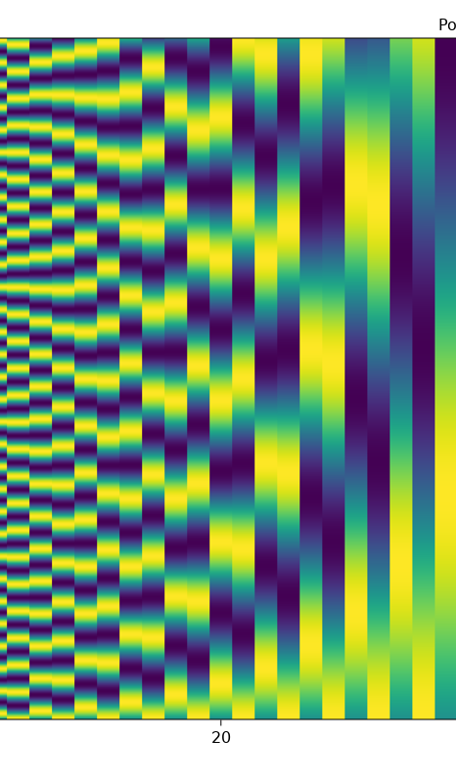
Transformers
Multiple encoder-decoder layers, each successive layer processes the preceding layer’s outputs; finally a linear transformation and softmax.
Each encoder and decoder includes attention layers.
First encoder takes embedding and sinusoidal positional encoding for each input token.
First decoder does something similar, with each output token.
GPT & BERT: specific restrictions on encoders & decoders.

Slide 27
Other innovations in Deep Learning
New variations of node functions
Different kinds of DNN architectures
Specialized memory units with recurrent connections (LSTMs and GRUs)—for predictions over time
Unsupervised feature learning
“Dropout”: deliberately ignore some nodes in each iteration of the training process
“Pruning” many connection weights to 0s
Connections that jump across layers

Slide 28
Concluding Remarks
LSTMs (and related models) are widely used in problems requiring prediction over time.
CNNs have revolutionized image analysis tasks, and have also been applied to other problems (with enough data, and where localized spatial features are useful).
Transformers have had a tremendous impact (via large language models) on processing text, speech and signals.
Active efforts are under way to reduce the size and computational effort needed for these models: using an LLM often increases the cost of a search query by a factor of 10 or more; one solution is to develop smaller domain-specific LLMs.

